Slide 1
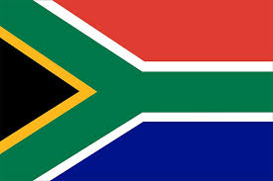

SOUTH AFRICA
By: Kendra, and Zankia

Slide 2
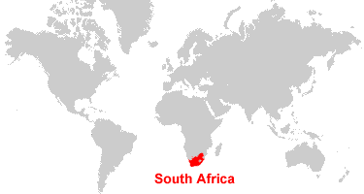
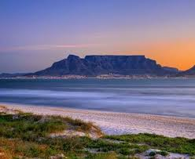
Country background
Language
South Africa is one of the countries known for language diversity, they have 12 official languages. They are divided into 3 main groups Bantu language, Germanic language, and sign language.
Ethnicity
black 75.2%, white 13.6%, Racialized person 8.6%, Indian 2.6%
Religions: Christian 68% (includes most whites and Coloreds, about 60% of blacks and about 40% of Indians), Muslim 2%, Hindu 1.5% (60% of Indians), indigenous beliefs and animist 28.5%
South Africa is known as one of the most beautiful countries in the world
Notes:
zankia

Slide 3
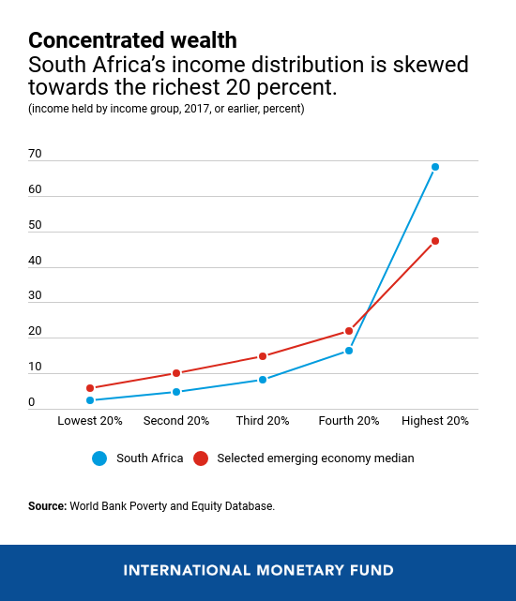
Global Issue
Income Inequality & Poverty
The top 20 percent of the population in south africa holds over 68 percent of income (compared to a median of 47 percent in other countries). The bottom 40 percent of the population holds 7 percent of income (compared to 16 percent in other countries). Similar trends can be observed across other measures, such as the income share of the top 1 percent. South Africa's unemployment rate is much larger than in other emerging markets. Youth unemployment rates going over 50 percent. This creates more low-skilled jobs to improve labor force participation. The unemployment rates exceed 30%, and systemic barriers persist. This leaves about 60% of the population living below the upper-middle-income poverty line.
Notes:
Kendra

Slide 4
Country’s response
The South African government has used different techniques to deal with the stubborn levels of inequality that have worried the country. Including through progressive fiscal redistribution,
(Progressive fiscal redistribution refers to the process of reducing economic inequality by combining a progressive tax system (where tax rates increase as income increases) with targeted social spending and transfers. Governments collect higher revenues from high-earning individuals and corporations, using these funds to provide services, subsidies, and income-support programs for marginalized communities)
https://www.imf.org/en/blogs/articles/2017/10/11/inequality-fiscal-policy-can-make-the-difference
Notes:
zankia

Slide 5
Consequences
Notes:
kendra

Slide 6
Canadian Comparison
Notes:
zankia,kendra

Slide 7
Sites!!
https://www.imf.org/en/news/articles/2020/01/29/na012820six-charts-on-south-africas-persistent-and-multi-faceted-inequality
Notes:
Kendra,zankia

